Slide 1
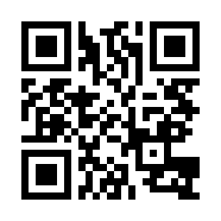


Objects, Functions and Modules Quiz
https://bit.ly/3gEQUtL

